Slide 1
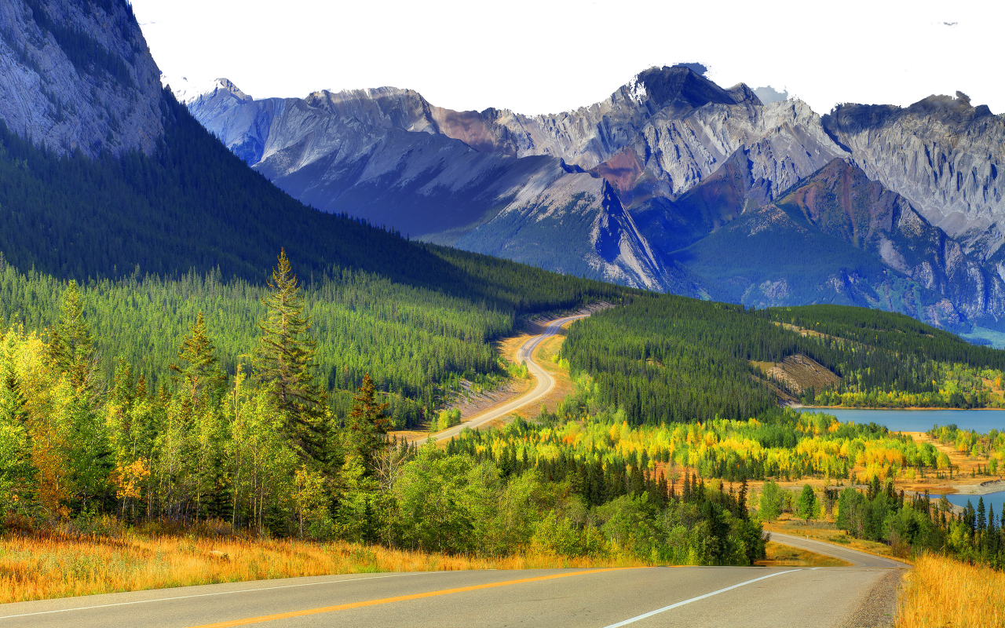
The Wonders of Nature

Slide 2
Presented by:
Habiba Akter Keya
Batch:41
Roll:01-041-24
Department: Management Studies

Slide 3
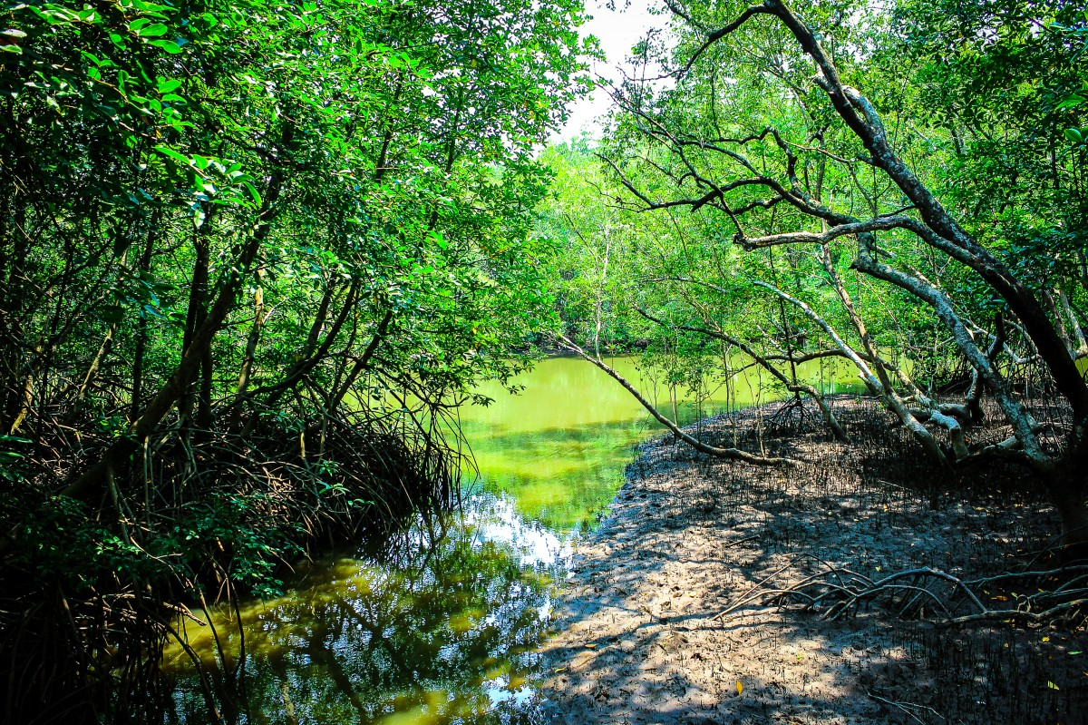
Forest
The largest areas of forest are in the Chittagong Hill Tracts and the Sundarbans. The evergreen and deciduous forests of the Chittagong Hills cover more than 4,600 square kilometres (1,800 sq mi) and are the source of teak for heavy construction and boat building, as well as other forest products.

Slide 4
Forest types | Total area (m.ha)
Hill forest | 1.40
Mangrove forest | 0.74
Sal forest | 0.12
Village forest | 0.27
Total | 2.53

Slide 5
Mangrove losses and gains
National conservation policies
National governance
Local economic activity

Slide 6
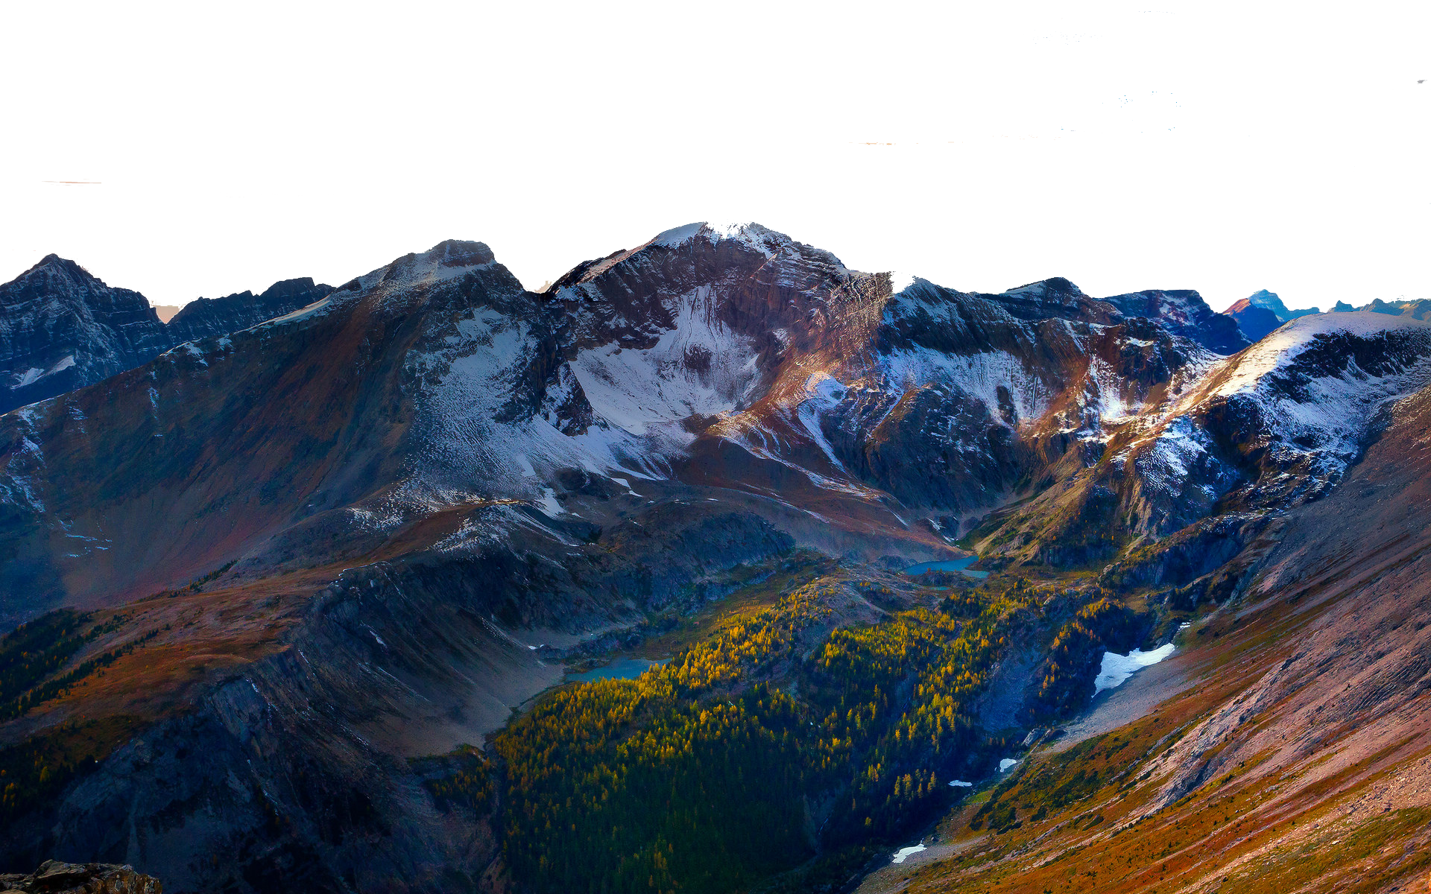
Mountains
There are 83 named mountains in Bangladesh. Keokradong is the highest point. The most prominent mountain is Kris Taung. In Bangladesh, there are numerous mountains in the Chittagong Hill Tracts areas. We are blessed with a lot of beautiful mountains in the world. Our world is filled with amazing natural beauty. The mountains make the overall natural landscape outstanding.

Slide 7
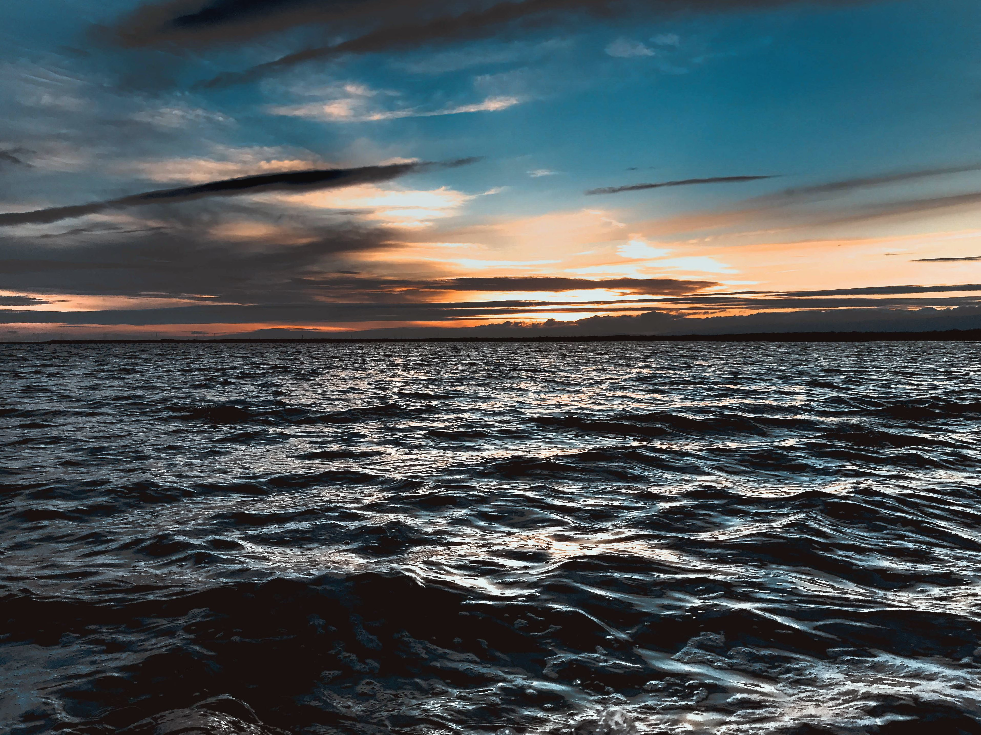
Oceans
Bangladesh, with a sea border facing the Bay of Bengal, claims to have the world's longest sea beach, a sea beach with a view of sunrise and sunset and a unique coral sea beach. Here is a list of sea beaches located in Bangladesh.

Slide 8
THANK YOU

